Slide 1

List-Based Scheduling in High Level Synthesis
By Emirkan Sali

Slide 2

Motivation
No first system prototype works out perfectly
Constant changes of aspects in development
Hardware first and Software next
Typical design flow is time consuming
High Level Synthesis solution with different steps
Scheduling as an important step

Slide 3
High Level Synthesis (HLS)
Processes high level language into Hardware description language (HDL)
Creation of Control Data Flow Graph (CDFG)
Scheduling of CDFG
Allocation
Binding

Slide 4
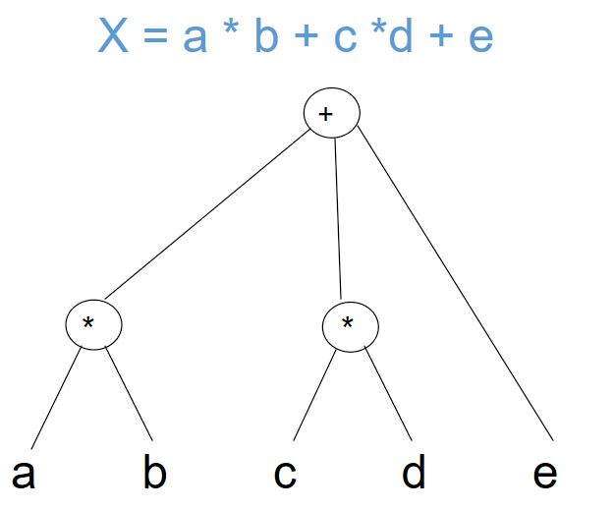
Conversion Example

Slide 5
Scheduling
Determination of the start of each task in the sequencing graph
Taking into account resource and design constraints
Assigning ressources to needed computations
Two types of scheduling algorithms:
Exact algorithms
Heuristic algorithms

Slide 6
List-Based Scheduling
Heuristic type of scheduling that solves resource constraint problems
Extension of Hu‘s algortithm
Works according to a priority list
Vertices are labeled with a weight
Most urgent operations are scheduled first

Slide 7
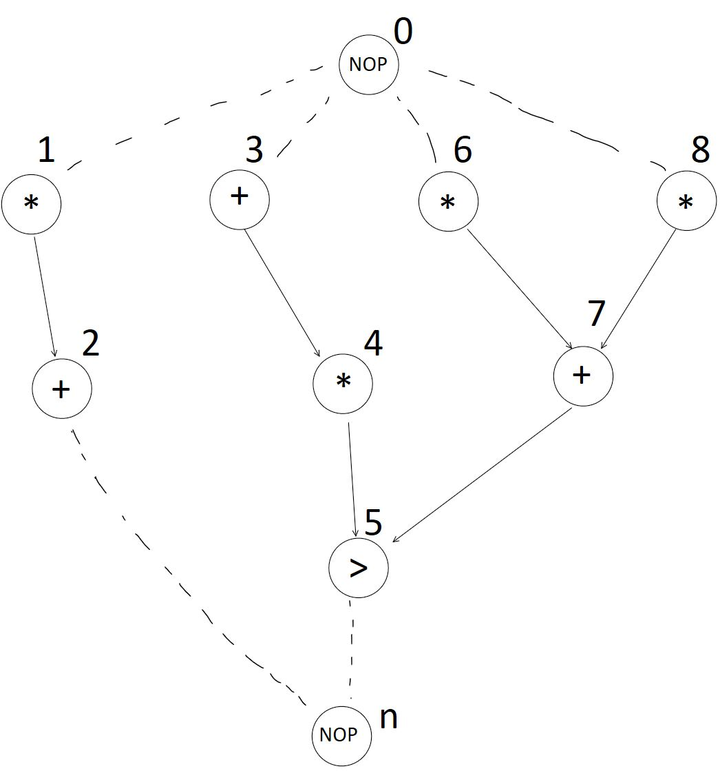
Example of a CDFG ready to be scheduled

Slide 8
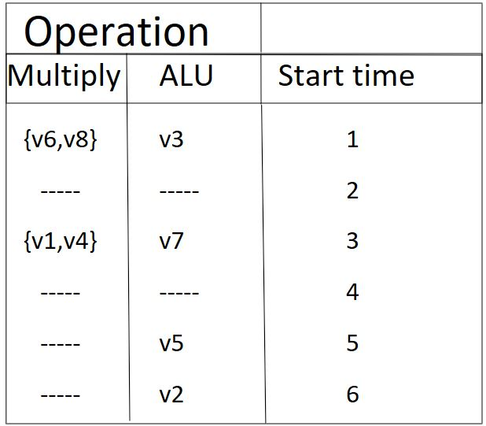
Priority list for the CDFG

Slide 9
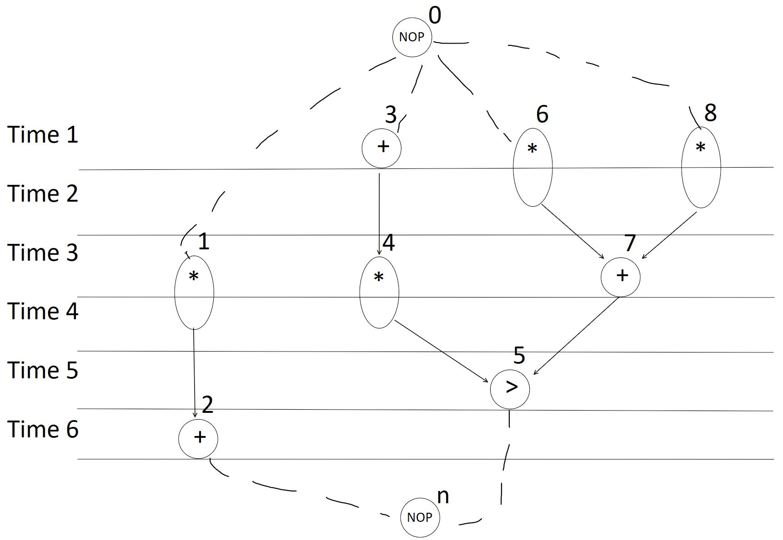
Resulting Graph with timing of operationms

Slide 10
Summary
HLS is a powerful tool for engineers and designers
List based scheduling: simple but efficient algorithm
Does not find absolute optimal scheduling solution
Mostly sufficient and less time consuming

